Slide 1
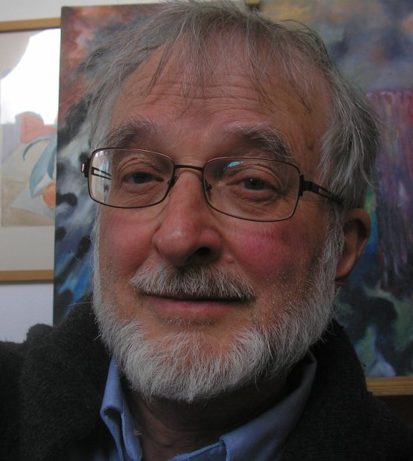
Dear Mellow
I send you a serie of my pictures. They are together with some short texts. Some of them you already knows, others may be new to you.
Thank you for housing us last month. Give hugs and kisses to Thøger and Baltazar from Elias

Slide 2
From Denmark to Tucson Arizona. 24 hours. After sitting I must move around. I cut some boards in pieces and start drawing on them.
Then come the colors. A tiny collection.
Here they come as a palisade on parade.

Slide 3
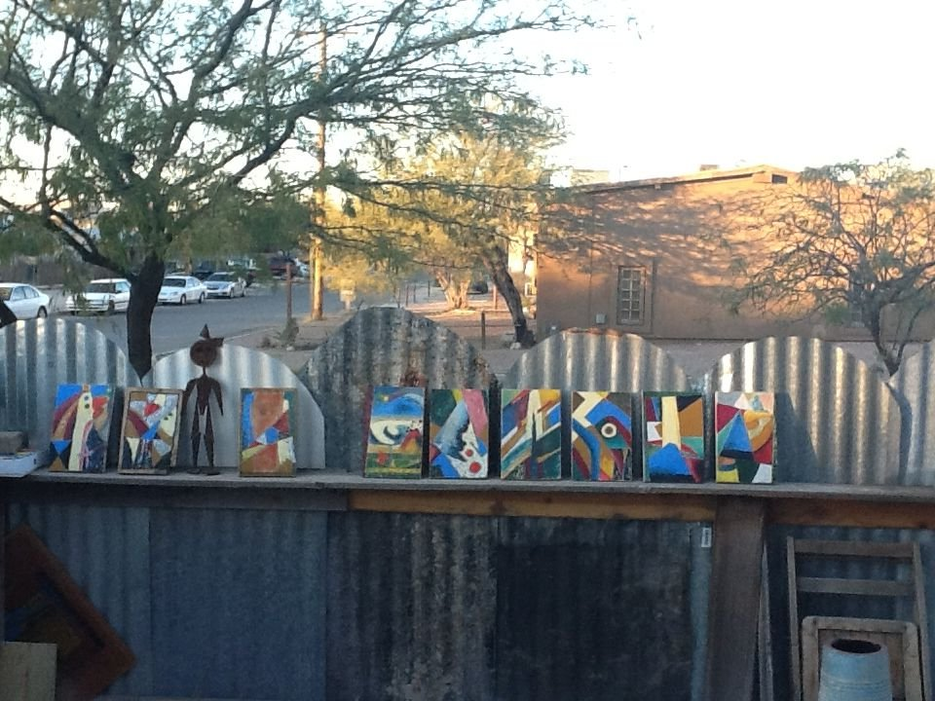

Slide 4
Tucson in the Sonoran desert
The volcanic mountains of old. Saguaros are on the alert round the city. They stand there with their arms.
Swallow up barrels of water for the dry months.

Slide 5
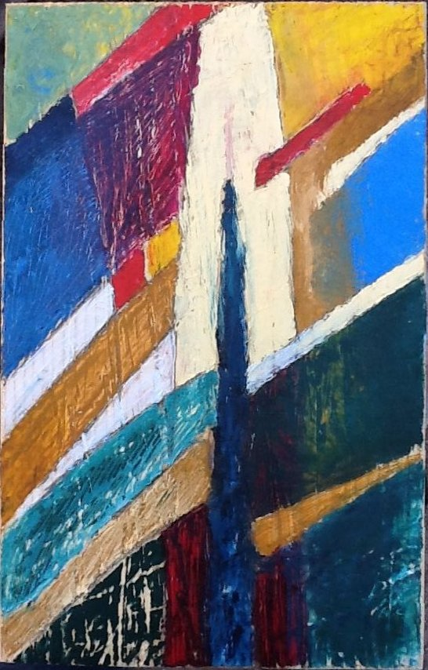

Slide 6
Hippies from near and afar find the deserted Bisbee, close to the Mexican border.
Strong colors on the walls. It’s worth a trip.
Look down the open mines.

Slide 7
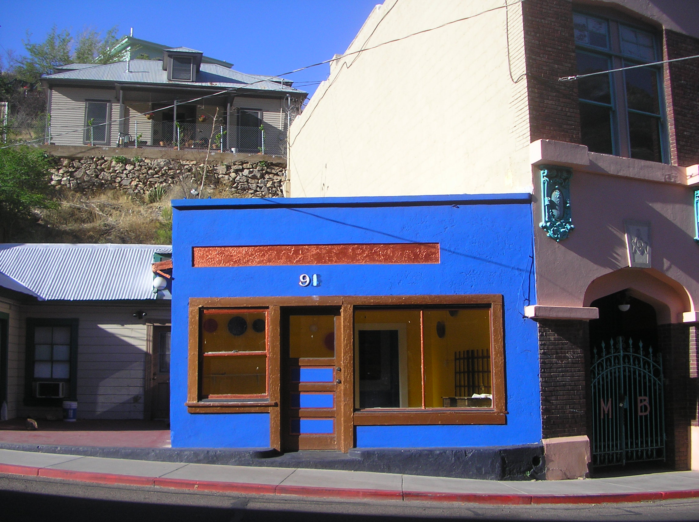

Slide 8
A volcanic landscape in many aspects.
An inferno of red-hot stones and ashes – the wildest fantasy…
The desert sand is what has been left.
Soon the monsoon will clean the landscape
Leaving behind dried-up washes.

Slide 9
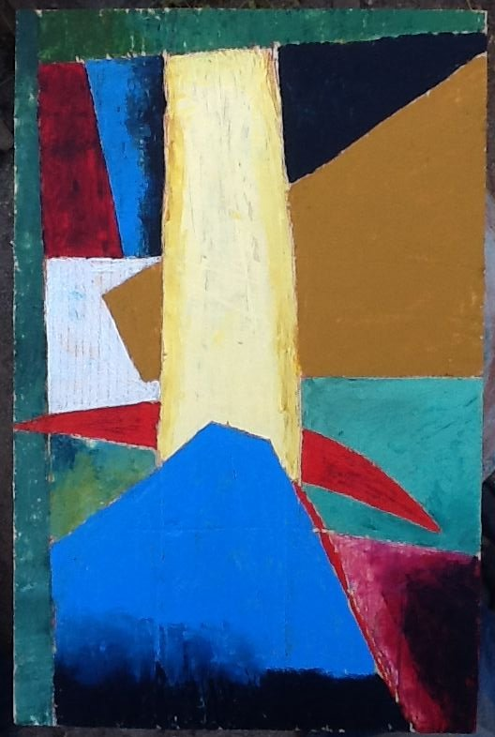

Slide 10
The arrows of light combine the fine leaves of the mesquites,
shadows on the wall, it is afternoon. Water-melons must offer life to bowls of delicious salads.
The heat of the day lowers the speed you move around..

Slide 11
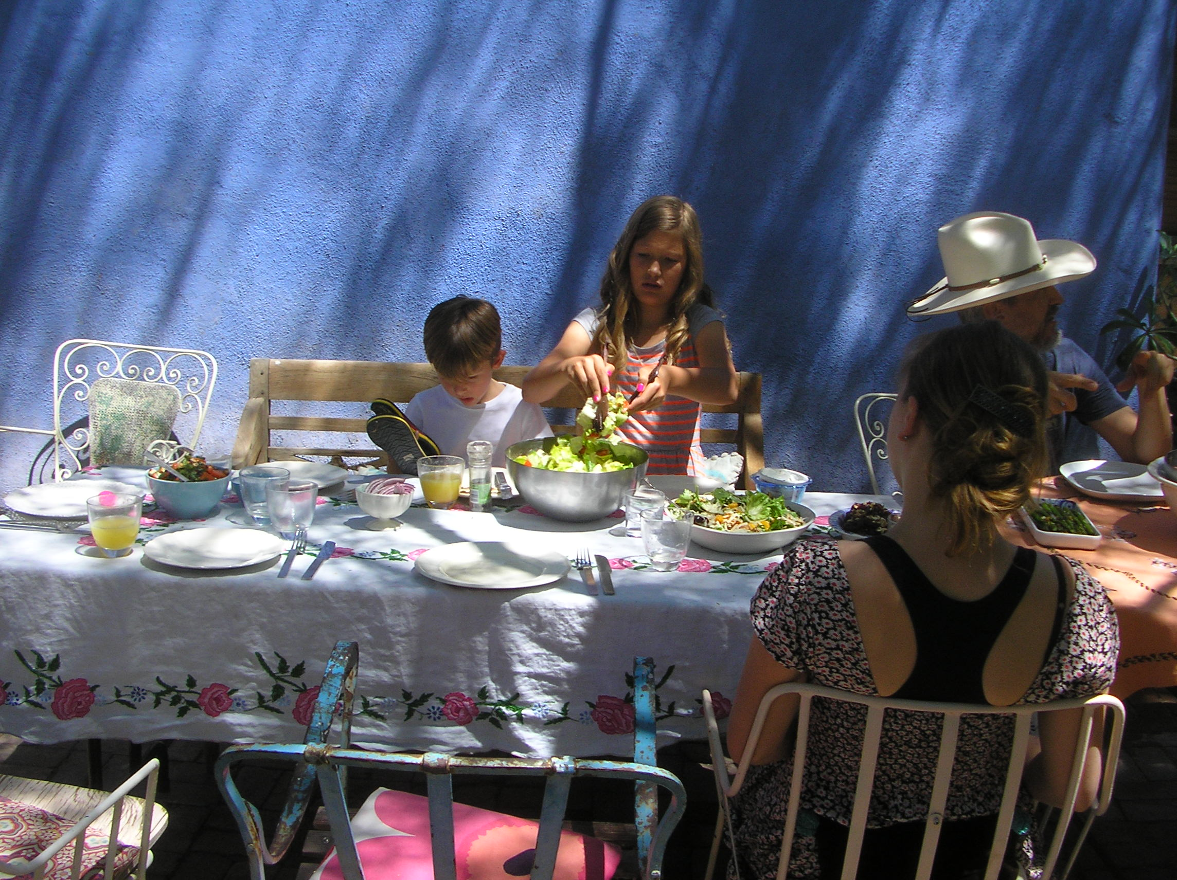

Slide 12
The mountains guard the city in respectful distance.
Rich houses occupy the slopes. The military airport covers central areas. People work there discharging goods for wars on other continents.

Slide 13
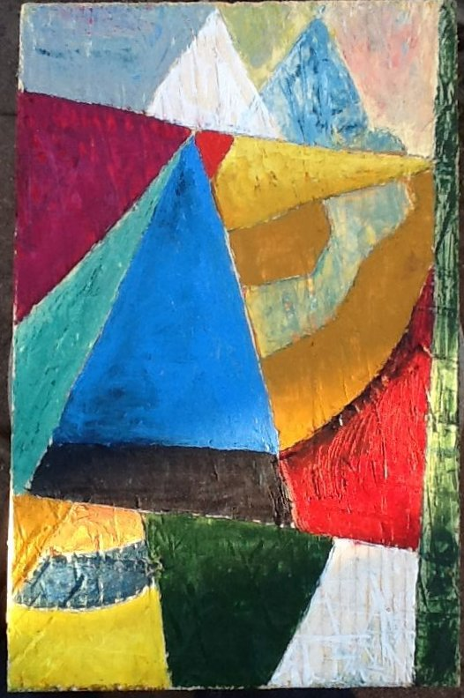

Slide 14
Adobe-houses in the old Mexican neighborhood. Walls of unburned clay and mud. Ceilings made from saguaros’ sticks. Colors reflect the sharp light
make the neighboring ones float.

Slide 15
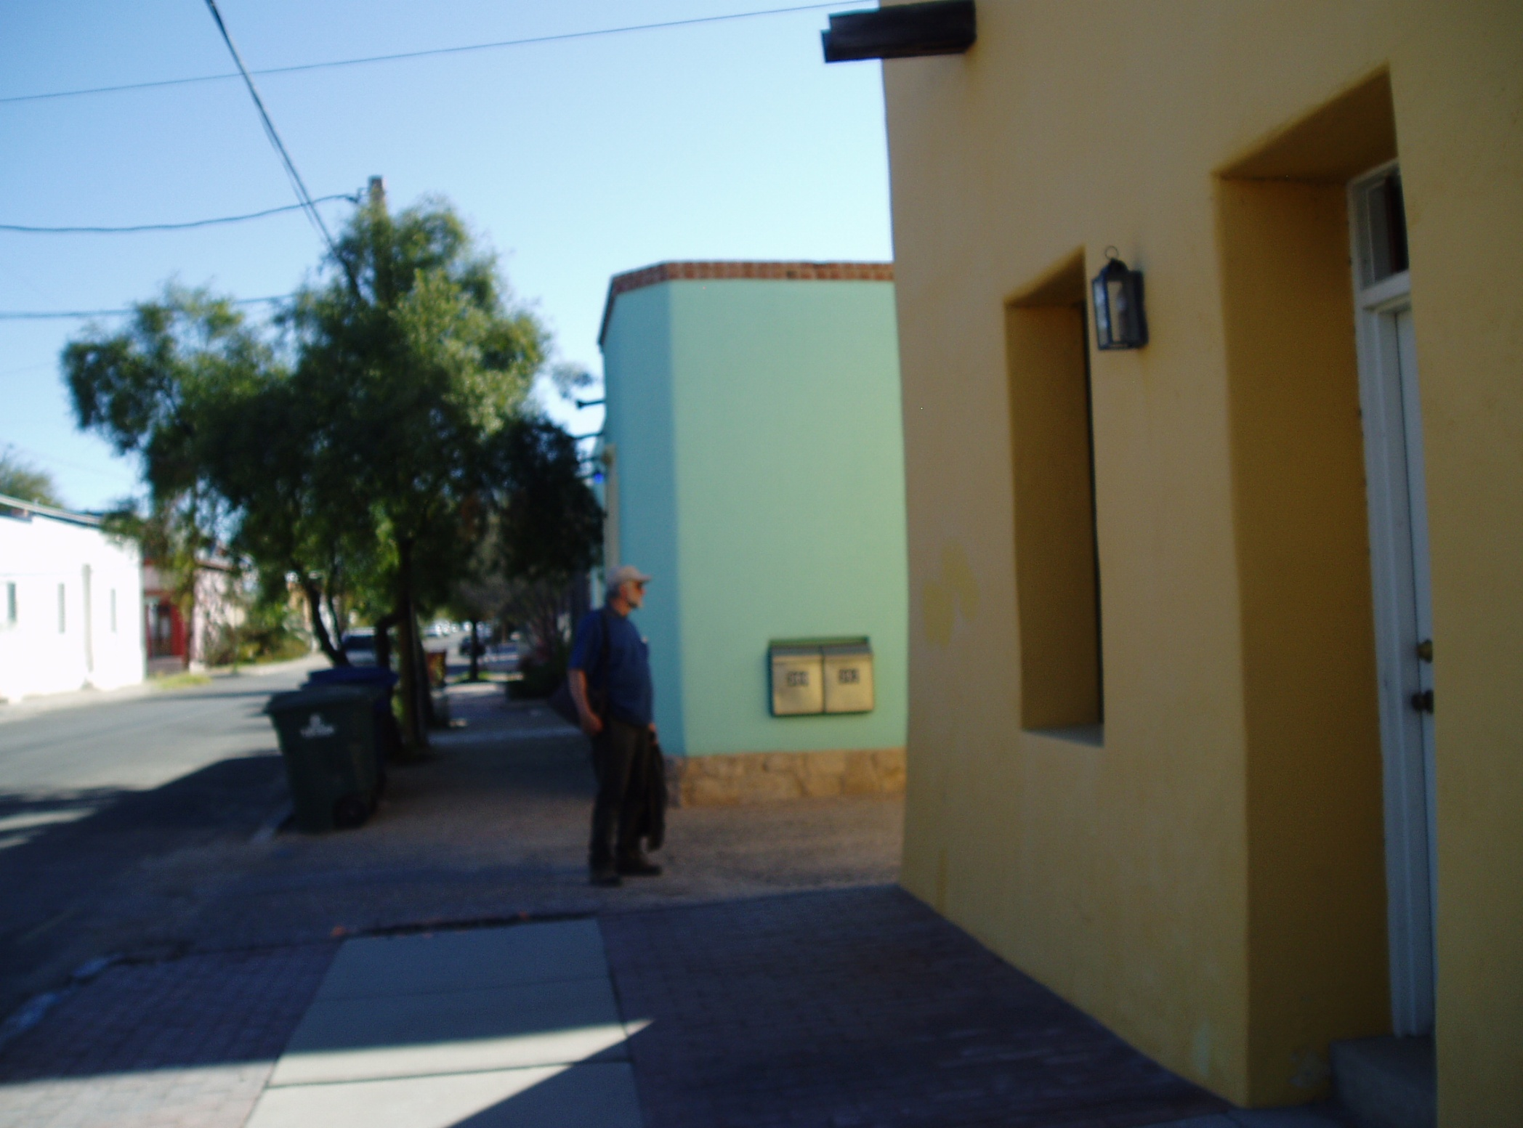

Slide 16
The musician sends flames of liberating scratches into the wood. My oilbars are getting soft in the heat.
The palette knife dances: squeezes color into the veins. The dead volcano is reborn and throw stones and fire.

Slide 17
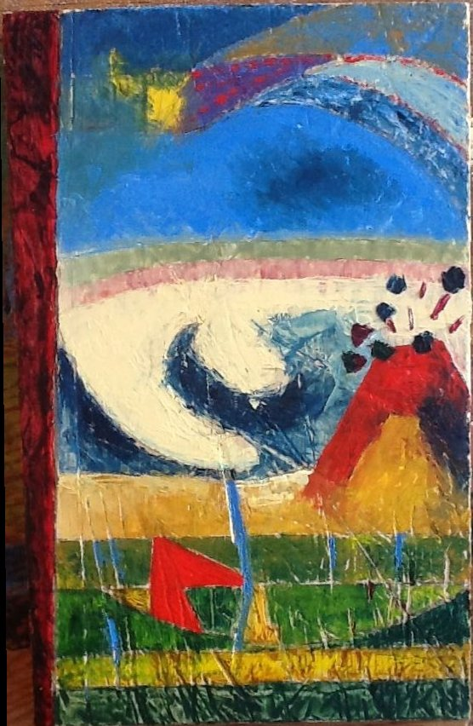

Slide 18
The scene changes to the heath of Western Jutland.
Ocean and wind waste away vegetation. Lyme grass draws circles in the sand.
Flowers of the heather turn grey. The wind forms barkans in the dunes.

Slide 19
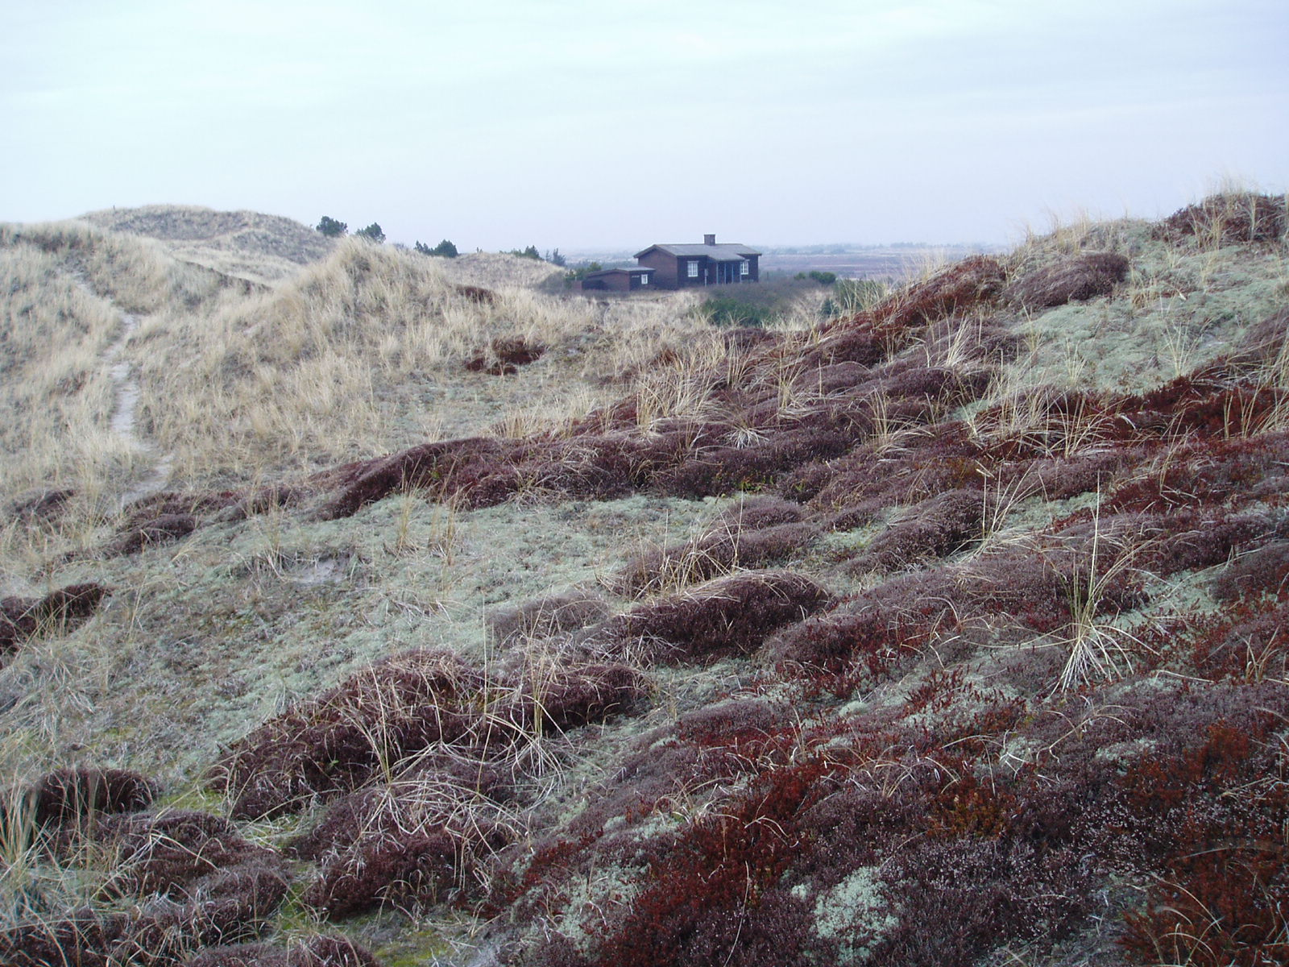

Slide 20
All I have learned about perspective.
I may hide all that stuff in trashcans.
Other methods must be found to catch this landscape. Lines and forms change as rapid as light.

Slide 21
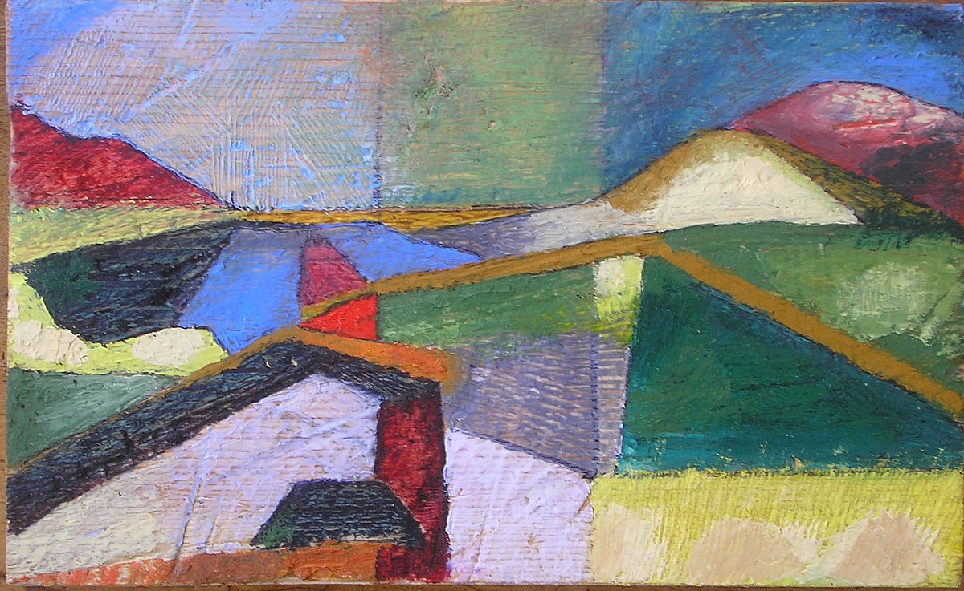

Slide 22
The colors here I have chained to an idea of this landscape ... I stick to them, I declare my loyalty to them.
- strictly connected to these sloping lines … The unwillingness of this landscape have I ruled by squares.

Slide 23
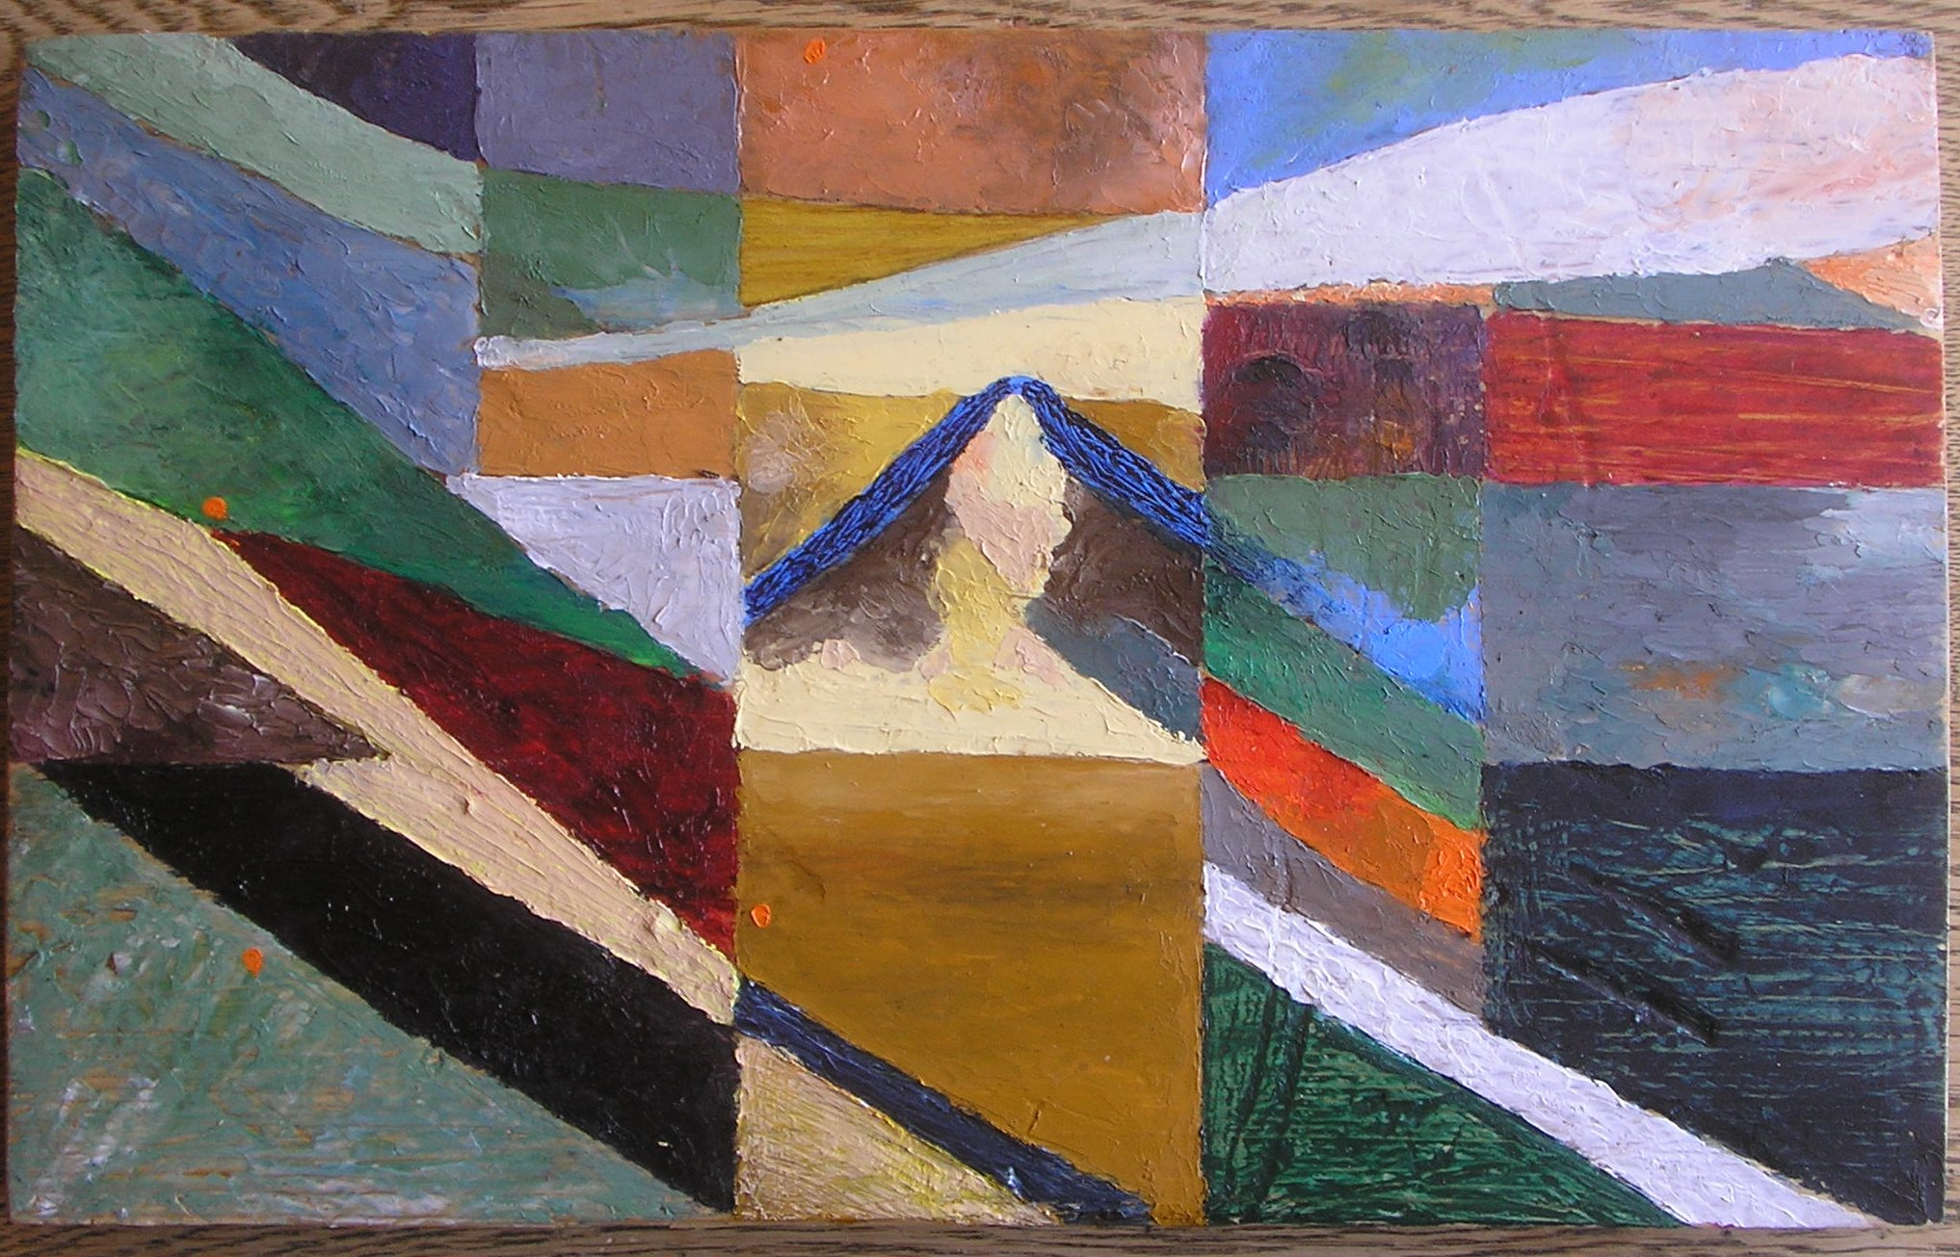

Slide 24
The ocean is out there behind the dunes, roaring. The noise from the world may be all the same
It will disappear in competition with the sound of the ocean.
Escape from the plague … empty your mind - but gateways will be closed.

Slide 25
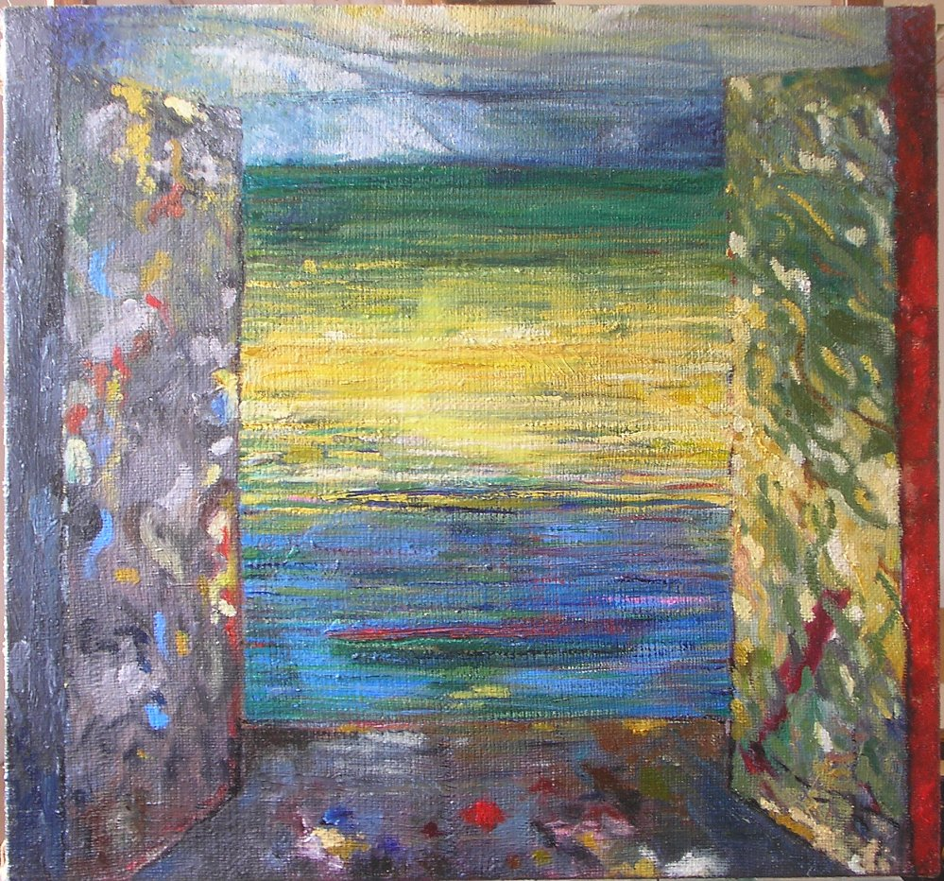

Slide 26
The flat moor named Monnet - the shining waters form mystical figures
Like mirages from maps of distant planets.
Young cattle munch.
Clouds are ascending. Birds’ screams over your head. You must leave this place.

Slide 27
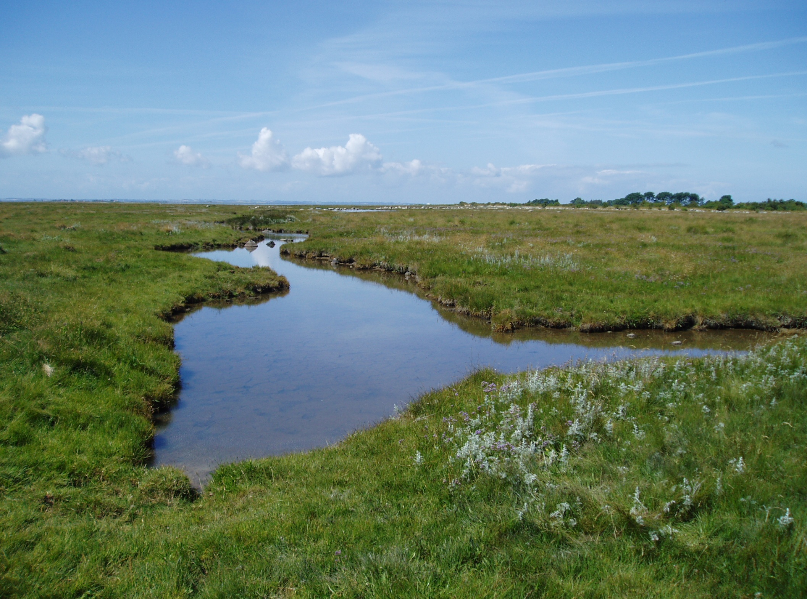

Slide 28
The rough canvas accept all that I give it.
The low horizon. The green soil. The squares. The ovals.
There are clouds ascending, rebellious they are!
I cannot know what will happen the next moment.

Slide 29
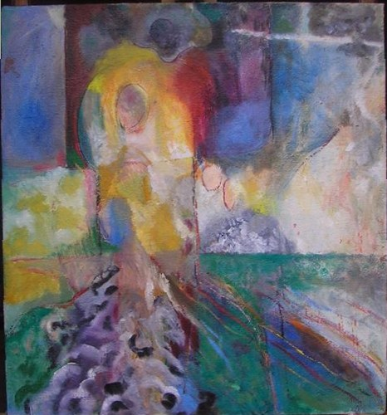

Slide 30
Something struggles. A human shape -
angry expression – is hiding over there.
Slender tracks from the brush, red and blue search for miracles.
Earthenware from creation … split up in pieces fragments fill the air and dive.

Slide 31
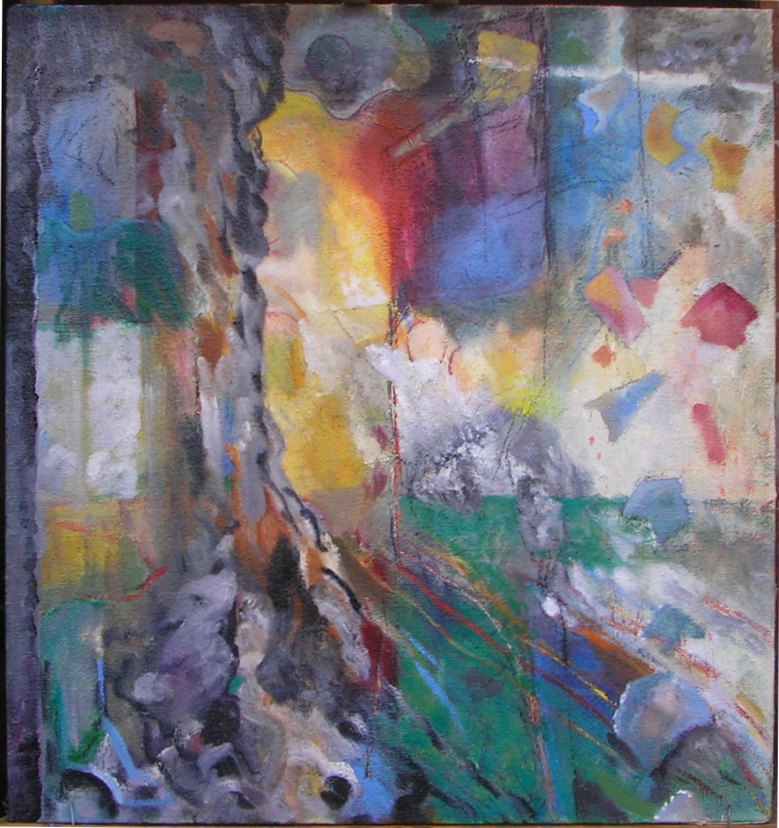

Slide 32
All that tempting to find a meaning at last.
Fragments from the potters’ workshop hail down. An inextinguishable gleam – through a carpet –
the dark material hides completely for us.

Slide 33
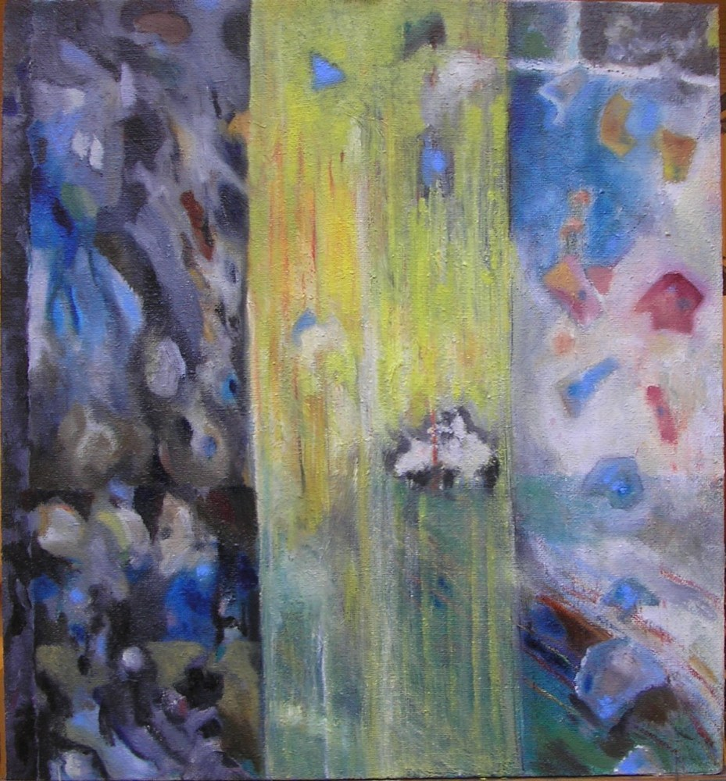

Slide 34
You must understand, that fragments ...
And the solid ground is not that secure …
And the firm pillows are swaying …
And the falling waters are heard in the darkness …
Nobody dares to go outside.

Slide 35
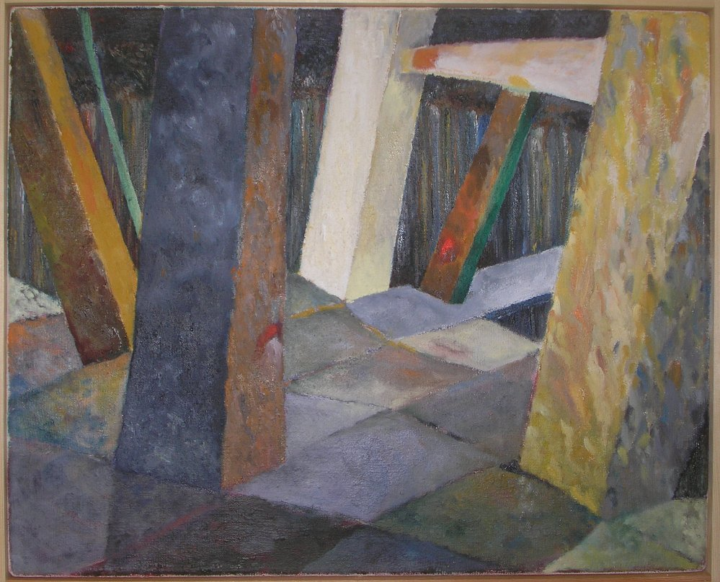

Slide 36
All I know has been turned upside down
Bodies are floating among clouds ... lakes of mercury, the soil shake itself.
Blue flames rise from fires – turn the sky black.

Slide 37
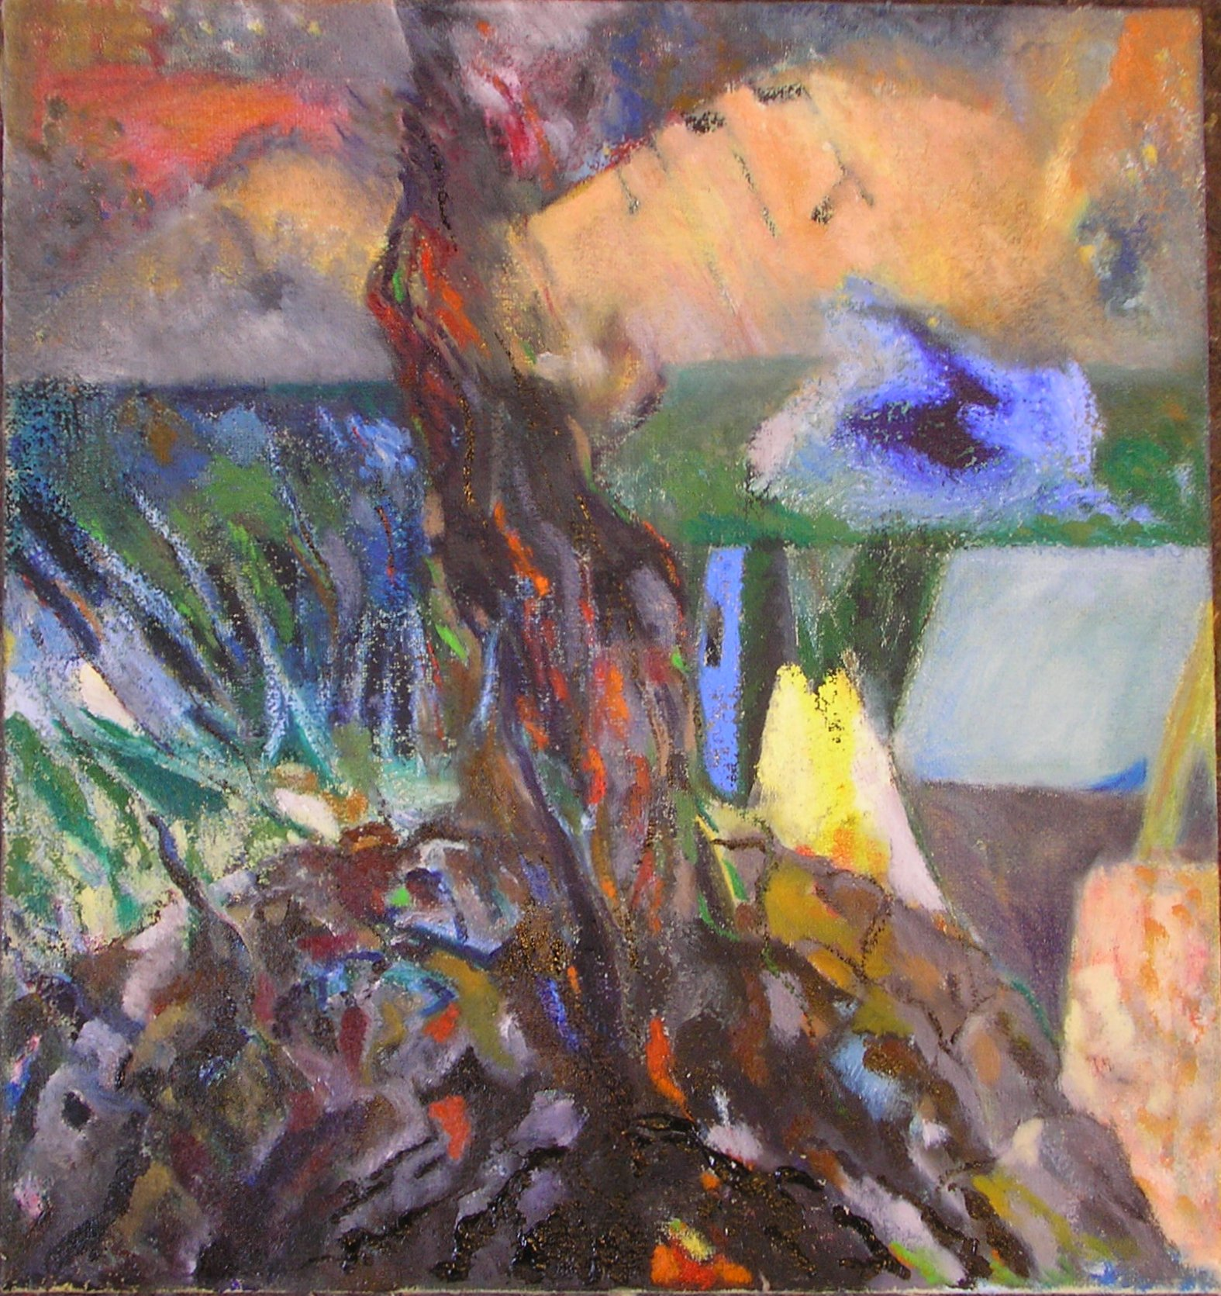

Slide 38
Railroad-engines come in at stations.
Platforms lead to the abyss - the asphalt opens its chasm - ”Dona Dona Dona, Dona Dona Do Na Do”

Slide 39
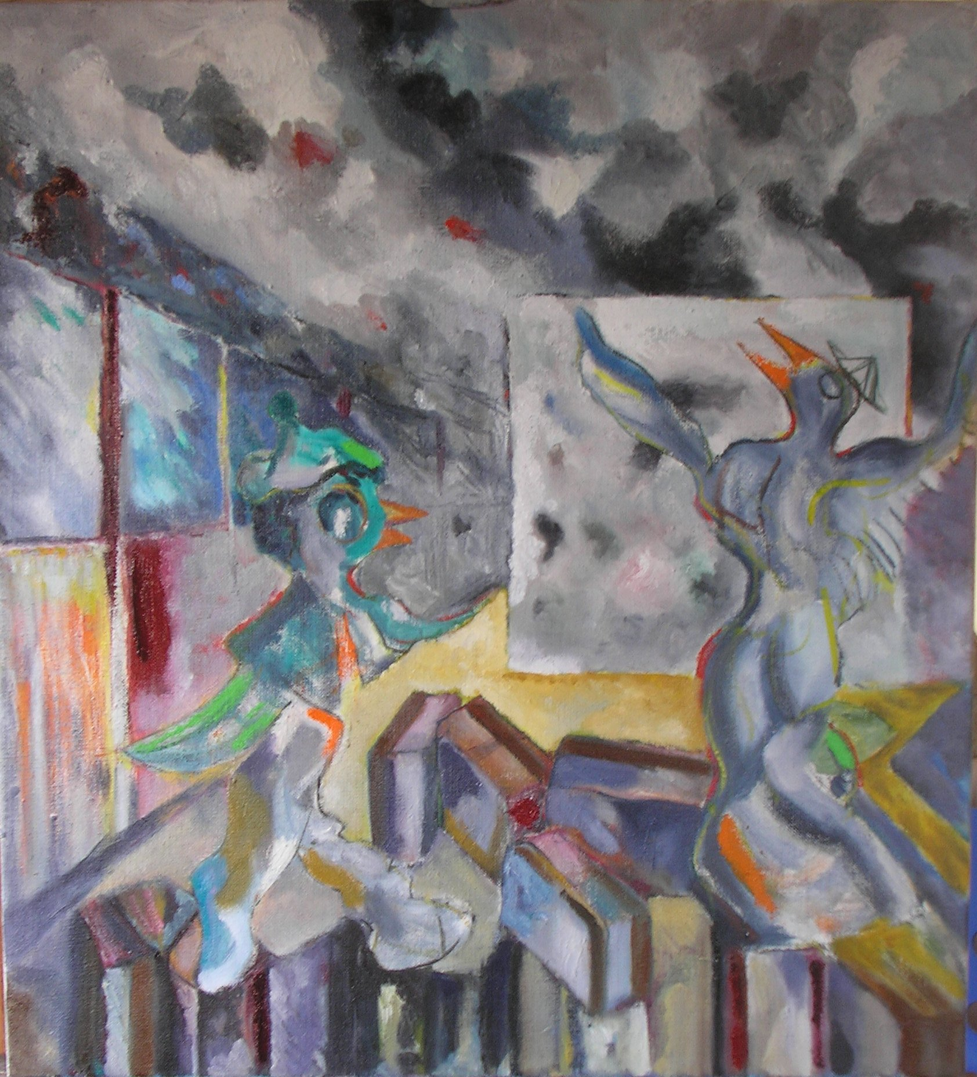

Slide 40
The bird asks you to dance: Fly like the swallow, fly high - You shall not be a slave for anybody. Calves will be slaughtered, but you must fly high.

Slide 41
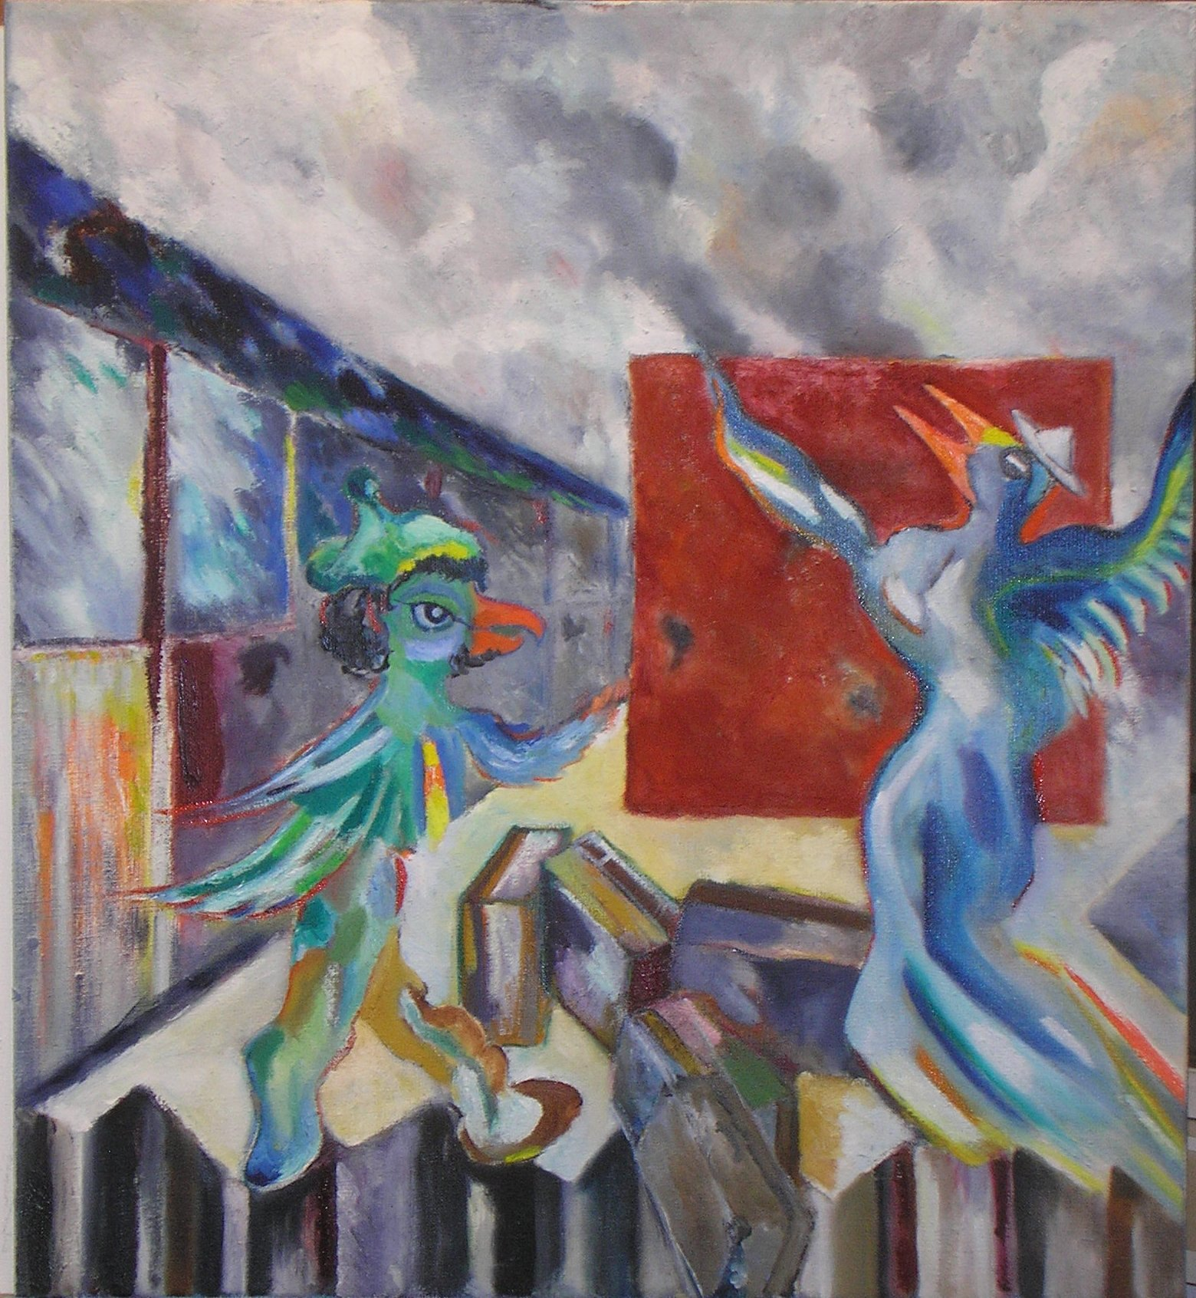

Slide 42
Texts, paintings and photography: Elias Tetens Lund 2014
otel @ mail.dk www.kotel.dk
Dona … melody: Shlomo Secunda 1940-41
Text : inspiration from Aaron Zeitlin 1940-41 visual inspiration: The Birds’ Haggadah

